Slide 1
Web Frameworks Mini Project (Online Library System)
1.Divya T Puranam (PES1201700749)
Email:divyaa.puranam@gmail.com
2.K Anjali Kamath(PES1201701674)
Email:kamathanjali1999@gmail.com

Slide 2
Website Description:
We have created an online library system called ‘BookHunters’.
This project was developed using Django.We have incorporated functionalities like login, logout, signup , borrowed books , due date etc.
On logging in , the user is redirected to the home page and is greeted by a message . If the user types an incorrect password , he is notified .
A new user has to first signup ,doing which he is redirected back to the login page and must login. The new user is then added to the list of ‘Users’ in the Django admin page . On successfully logging in , the user can check the books available , the list of books that he has borrowed along with the due date . On logging out , the user is again redirected to the homepage.
Website is hosted at : http://divyapuranam.pythonanywhere.com/

Slide 3
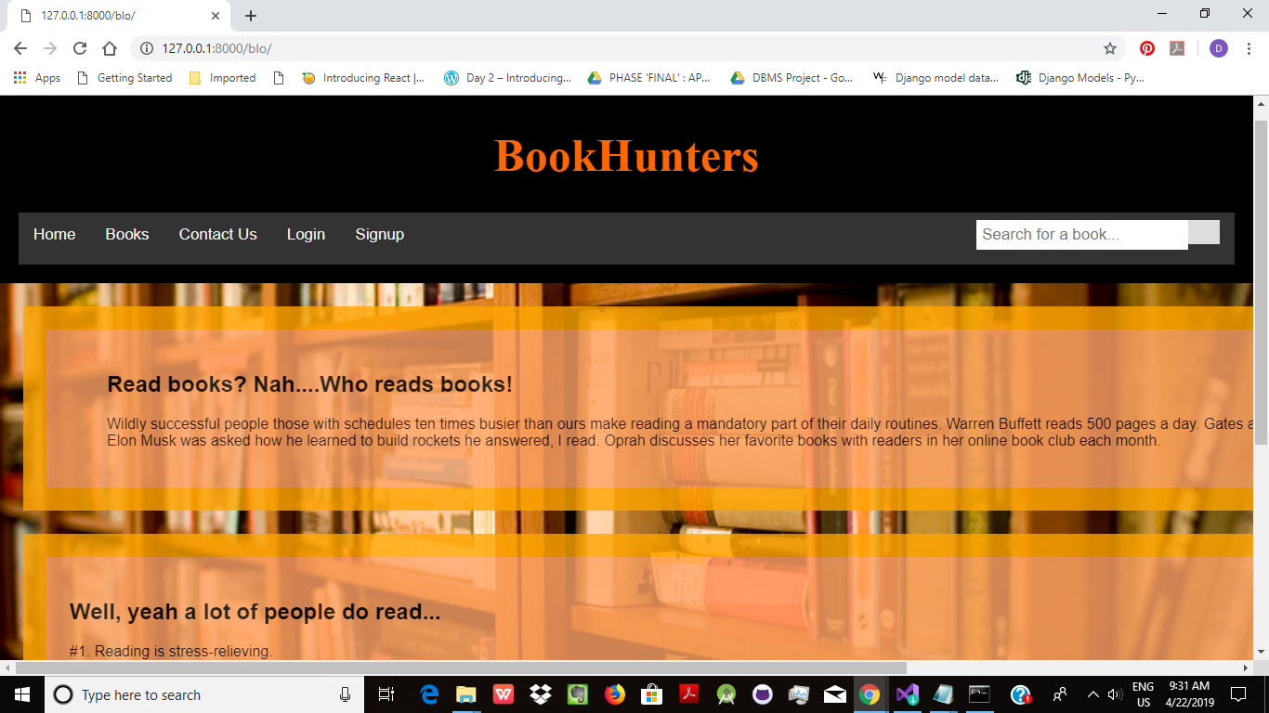
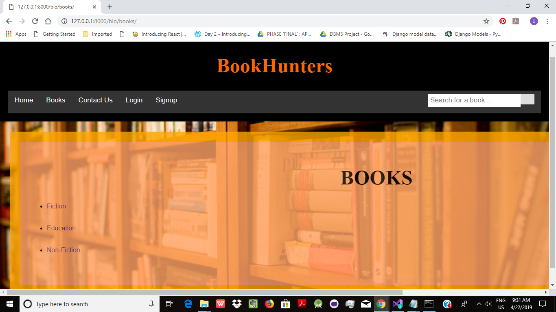
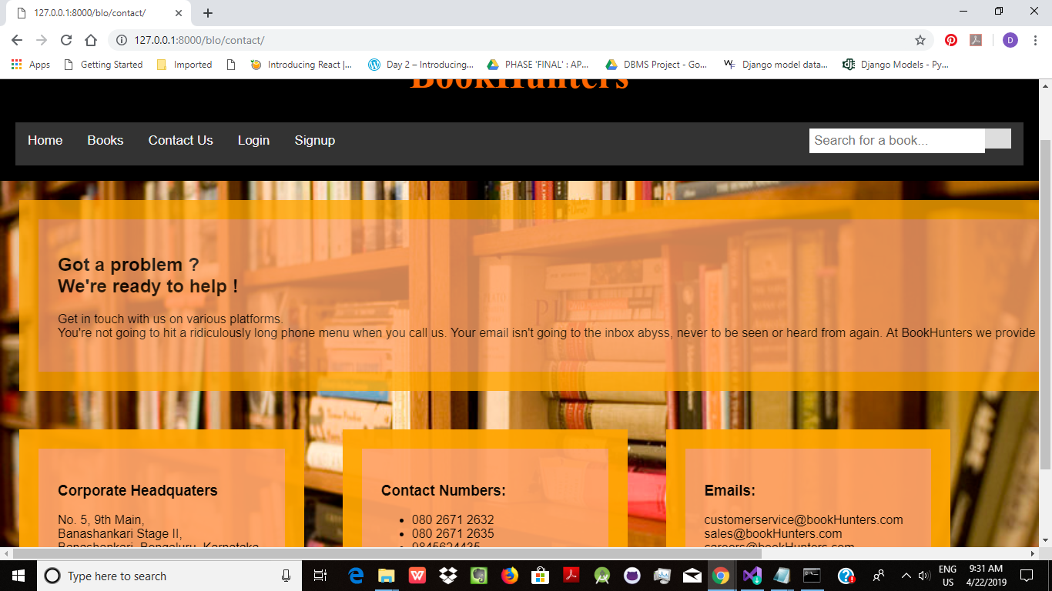
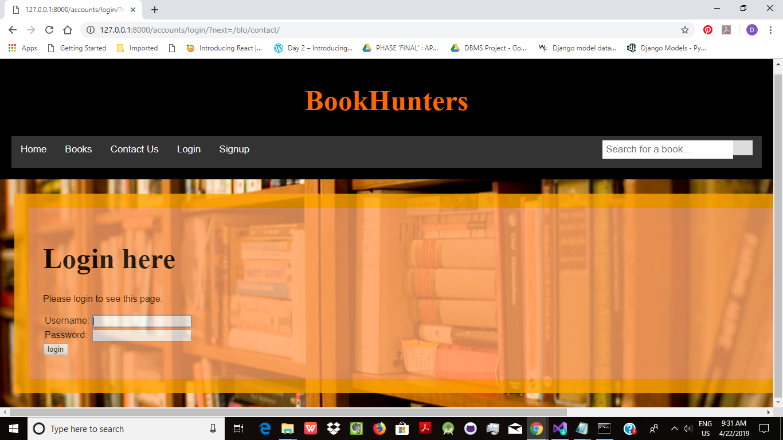

Slide 4
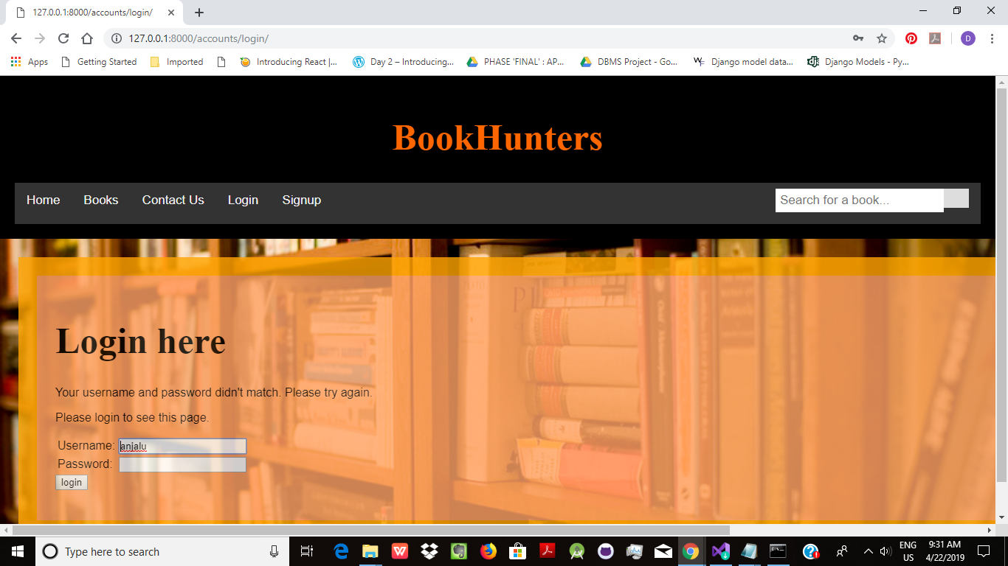
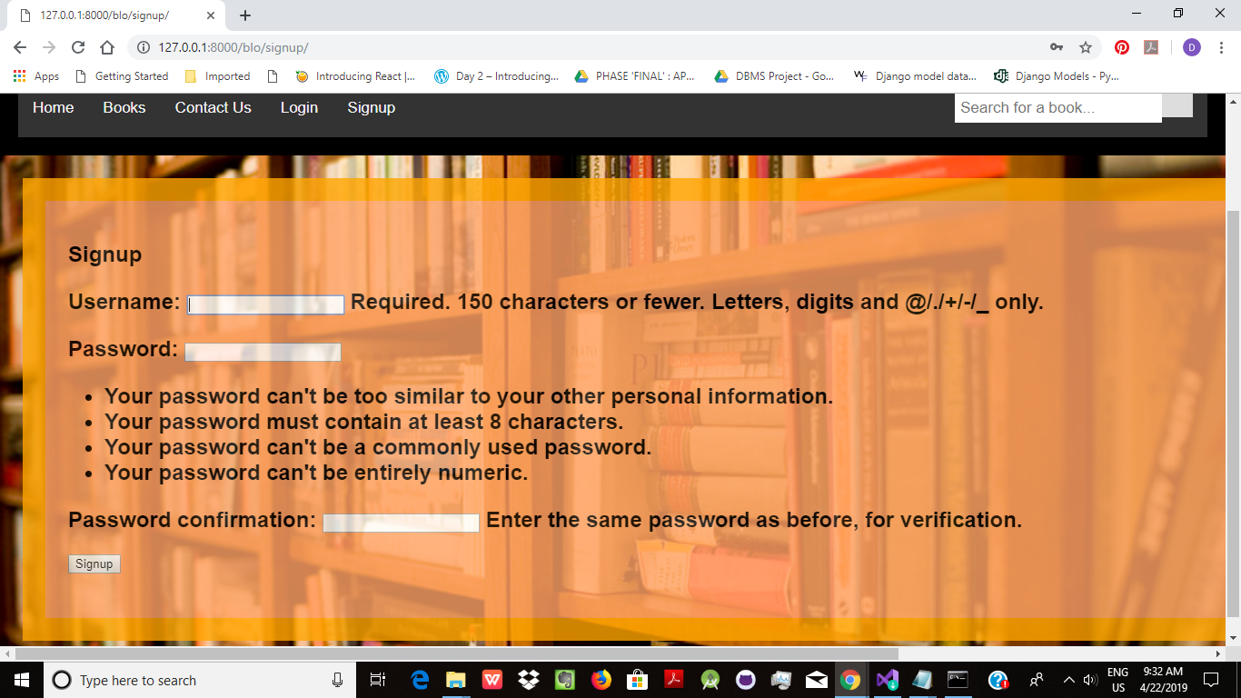
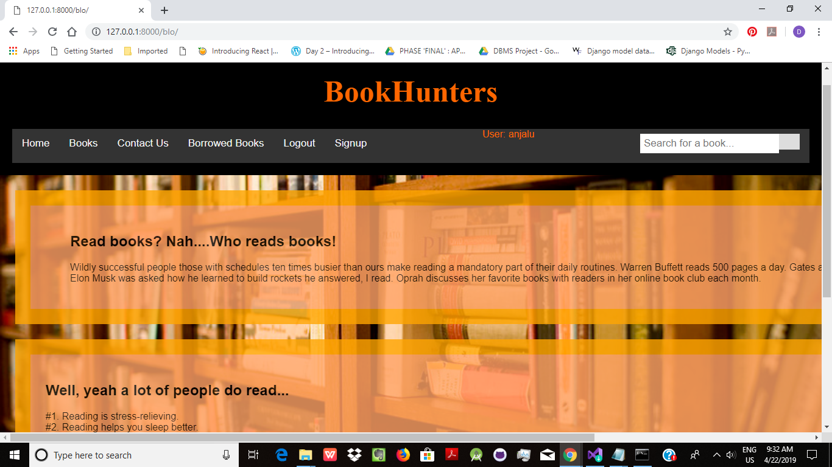
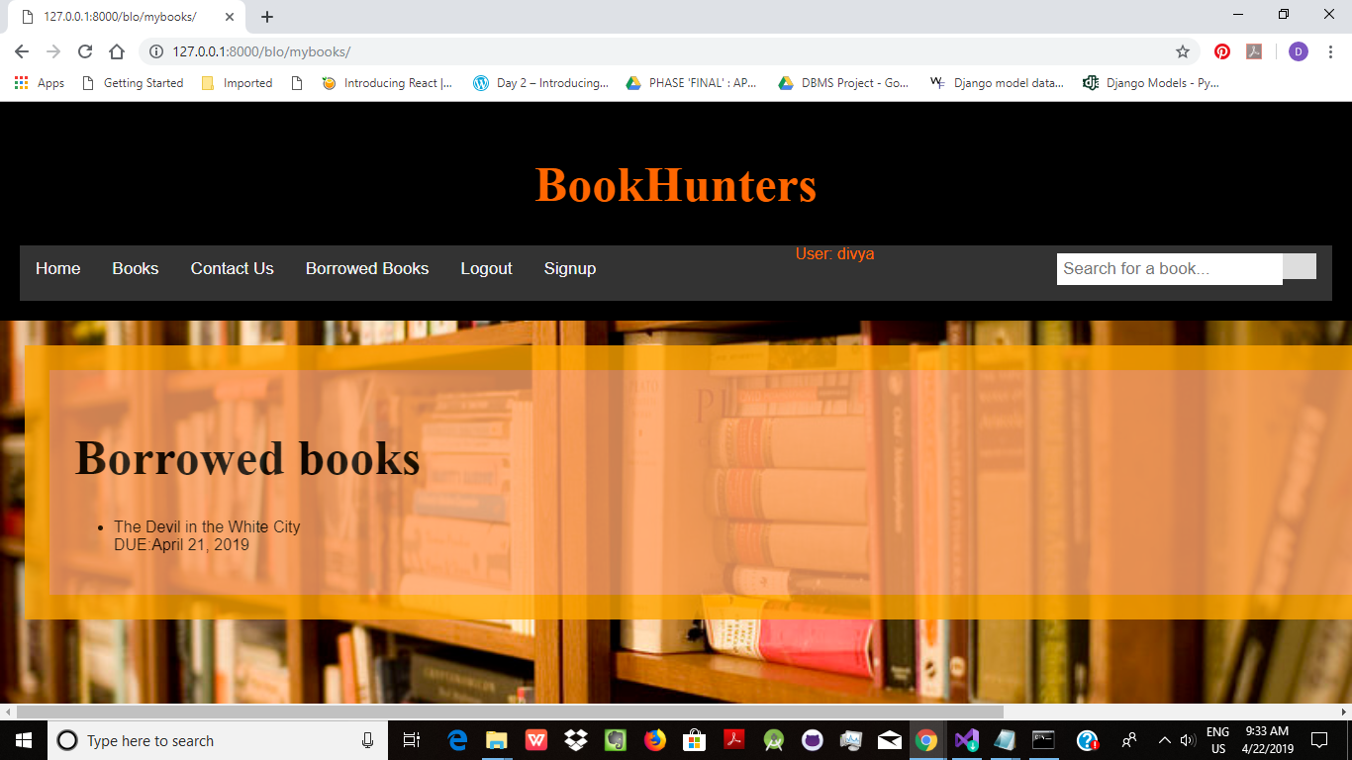

Slide 5
Takeaways and challenges:
We learnt how to create various tables in the db using models.py
We learnt how to make a common html file which can be used as the base for the other html pages in the website
We learnt to link various html pages together(using views.py and urls.py) and display the homepage directly on typing the ip address
We learnt how to use some of the built in functionalities available.
We learnt how to host the website live.
Allowing the user to log in ,storing new user in the db(while signing up),printing the books borrowed by the user along with the due date were some of the challenges faced.

